Slide 1

The BoC Cuts As Expected
Key Takeaways:
Bank of Canada (BoC) Interest Rate Decision: Following an initial rate cut in June, the BoC continued to ease rates further, announcing a 25 basis point cut to overnight rates, lowering them to 4.5% from 4.75%. The bank also indicated that it is continuing its policy of balance sheet normalization. While this announcement was in line with expectations, comments from BoC Governor Tiff Macklem remained focused on the population effect overshadowing broad-based weakness.
The Population Hangover: The Canadian economy is expected to have expanded by 1.5% in H1 2024, largely driven by an unsustainable 3% increase in the population. A deeper analysis reveals a “real” economy that is weak and still experiencing the hangover effects of elevated policy rates. As the BoC accurately highlighted in today’s release, “household spending, including both consumer purchases and housing, has been weak. There are signs of slack in the labour market, with the unemployment rate rising to 6.4%.” While the BoC is projecting the economy to grow by 1.2% for the full year 2024, it is not expecting a recovery back to the long-term trend until 2025, with growth projected to be slightly above trend at 2.4% in 2026.
Final Thoughts for Investors: There is no question that beneath the surface, the Canadian economy is slowing and in need of rate relief. While today’s rate cut will provide some relief to households, more is required to prevent a hard-landing scenario for the economy. Although Canadian equities are up 8.47% YTD, we remind investors that this is not a reflection of the state of fundamentals in the real economy.
Contact us at info@advisorinsights.ca to learn more about how we are advising our clients.
Info@advisorinsights.ca | www.advisorinsights.ca

Slide 2
More Cuts on the Horizon
BoC Cuts Rates from 4.75% to 4.5%
Info@advisorinsights.ca | www.advisorinsights.ca

Slide 3
Unsustainable Growth
Canadian Economy Driven by Unsustainable Population Growth
Info@advisorinsights.ca | www.advisorinsights.ca

Slide 4
Housing Feeling the Pressure…
Housing Pressures Persist
Info@advisorinsights.ca | www.advisorinsights.ca

Slide 5
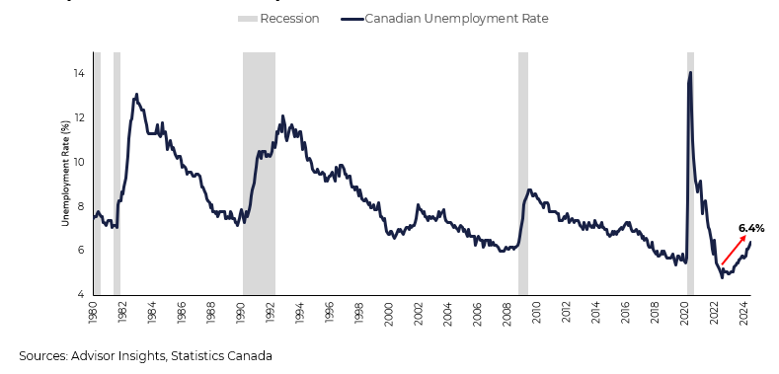
…and Slack in the Labour Markets
Population Growth Outpaces Job Creation
Info@advisorinsights.ca | www.advisorinsights.ca

Slide 6
Disclaimer The information provided in this document is for educational and informational purposes only. Advisor Insights does not guarantee the accuracy, completeness, or timeliness of the information provided.
Investing in financial markets involves risk, including the potential loss of principal, and past performance does not guarantee future results. The content of this document should not be construed as personalized investment advice or recommendations.
Readers are advised to consult with a qualified financial advisor or investment professional before making any investment decisions. Any reliance you place on the information provided in this document is at your own risk. Advisor Insights and its affiliates shall not be liable for any errors, inaccuracies, or omissions in the content, nor for any actions taken in reliance thereon.
By accessing this document, you agree to indemnify and hold harmless Advisor Insights and its employees from any and all claims, damages, or losses arising from or related to your use of the information provided herein. The information provided in this document has been obtained from sources believed to be reliable. However, the accuracy and completeness of these sources cannot be guaranteed, and they are used here as general sources of information.
Info@advisorinsights.ca | www.advisorinsights.ca

